Slide 1
Advanced Discrete Event Simulation in R
TA Trikalinos, F Alarid-Escudero, Y Sereda, SA Chrysanthopoulou
SMDM 2024 (Boston MA)

Slide 2
Disclosures
We have no financial or other conflicts to declare
All are supported by NCI ….
Trikalinos and Sereda developed and maintain the nhppp R package...

Slide 3
Sunday 27th of October 8:30 to 12:00
Time | Description | Discussant
[10 min] | Introductions and administrivia | Trikalinos
[20 min] | DES as a composition of point processes: what is a DES gentle introduction to one-dimensional point processes NHPPPs are often a good choice | Alarid-Escudero
[20 min] | NHPPPs – key properties that allow for fast sampling and justify clever tricks | Chrysanthopoulou
[30 min] | Sampling algorithms and the nhppp R package | Sereda/Trikalinos
[15 min] | Break
[90 min] | Guided exercise: Implement a simple cancer natural history DES, demonstrating unconditional sampling of events sampling conditional on the number of events, and sampling conditional on downstream events | All
[10 min] | Advanced Topic Teaser on self-excitatory processes: point processes that are not NHPPPs and when you may need them | Trikalinos
[15 min] | General Q & A | All

Slide 4
<Any slide about code of conduct etc. from the conference>
<Bathroom locations>
<Wifi and stuff>
<Format for the course>

Slide 5
Learning objectives
Be able to discuss:
Three properties of NHPPPs (memorylessness, composability, and transmutation by transforming the time axis) that are important for simulation
Sampling algorithms and their use via R’s nhppp package
How to do conditional simulations
How to structure the code of a basic DES

Slide 6


Background
Individual-level discrete event simulation (DES) models, usually require sampling times at which specific transitions or events could occur.
Event 1
Event 2
…
Death
Event 1
Event 2
…
Death
Notes:
or even the time when they died

Slide 7






Background
Each of the $k=1,…,K$ possible transitions or events for each of the $i=1,…,N$ individuals are described by hazard or intensity functions, $λ_{i}^{k}\left(t\right)$.
$$λ_{i}^{3}\left(t\right)$$
$$λ_{i}^{4}\left(t\right)$$
$$λ_{i}^{2}\left(t\right)$$
$$λ_{i}^{5}\left(t\right)$$
$$λ_{i}^{1}\left(t\right)$$
Event 1
Event 2
…
Death
Notes:
or even the time when they died

Slide 8
Point processes
Point processes are stochastic processes for which each realization consists of a collection of points, each point having a well-defined position, usually in one-dimensional space
In DES, points are events, and the one-dimensional space is usually time
Notes:
or even the time when they died

Slide 9




Birth
Entry
Entry
Lifespan
Simulation window
$λ_{3}\left(t\right)$: death from cancer
$λ_{2}\left(t\right)$: clinical Dx
$λ_{1}\left(t\right)$: generate tumor
$λ_{0}\left(t\right)$: death from other causes
0
40
110
Age (years)
(time)

Slide 10
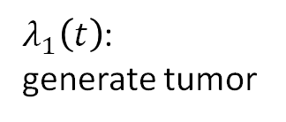
Birth
Entry
Entry
Lifespan
Simulation window
$λ_{3}\left(t\right)$: death from cancer
$λ_{2}\left(t\right)$: clinical Dx
$λ_{1}\left(t\right)$:
generate tumor
$λ_{0}\left(t\right)$: death from other causes
0
40
110
Age (years)
(time)

Slide 12
THIS SHAREPOINT IS THE GOLD VERSION TOM: I am doing section 2 in a copy on my local machine I will be adding slides here every hour or so

Slide 13
Section 2

Slide 14
The point process
A scheme that generates a series of events (points) over time

Slide 15
Section 3

Slide 16
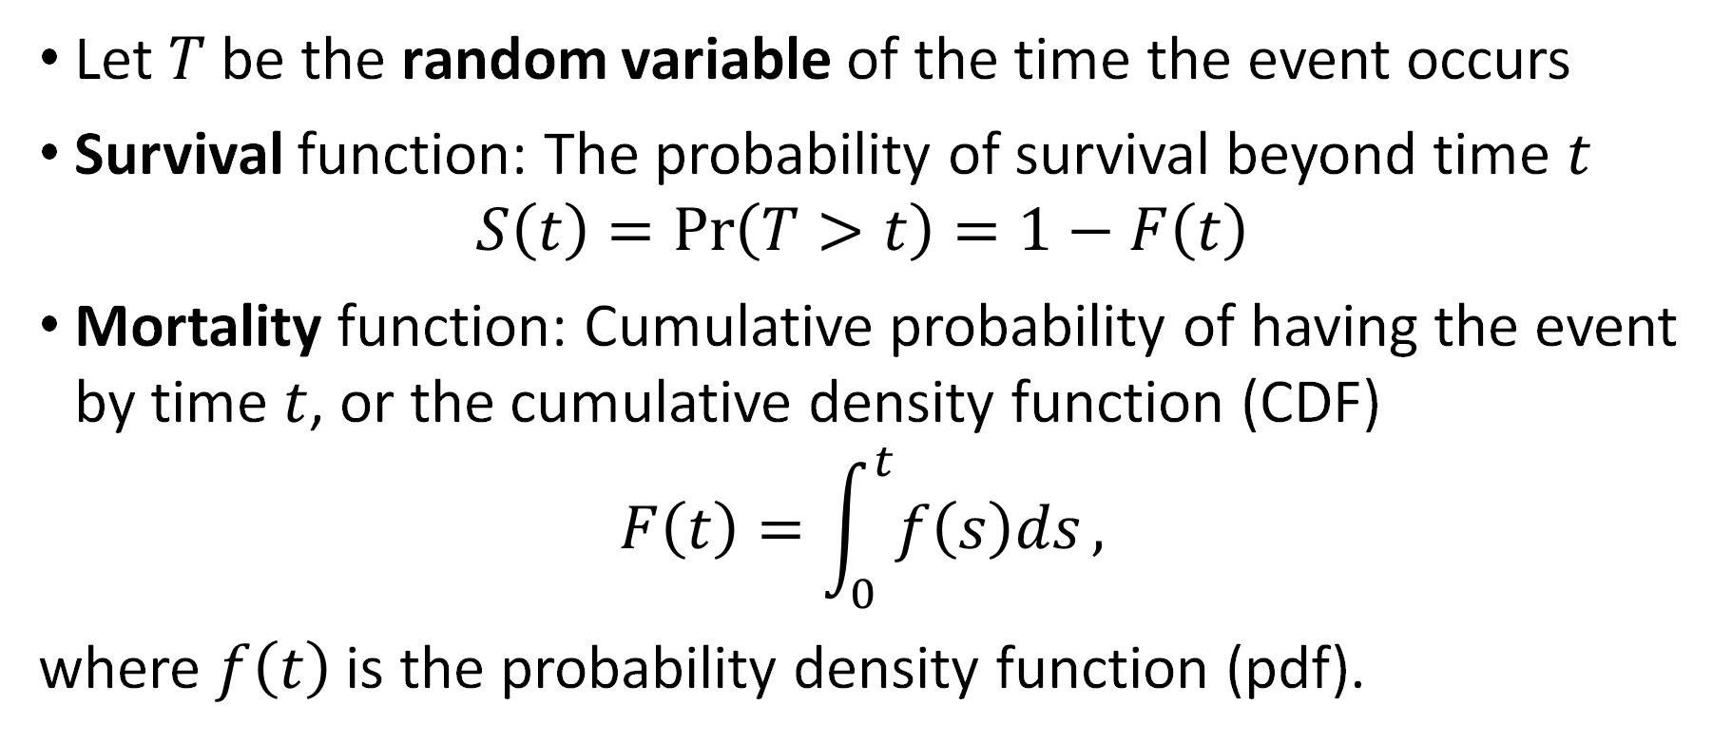
Survival analysis in a nutshell
Let $T$ be the random variable of the time the event occurs
Survival function: The probability of survival beyond time $t$
$$S\left(t\right)=\operatorname{Pr}\left(T>t\right)=1−F\left(t\right)$$
Mortality function: Cumulative probability of having the event by time $t$, or the cumulative density function (CDF)
$$F\left(t\right)=\int_{0}^{t}{f\left(s\right)ds},$$
where $f\left(t\right)$ is the probability density function (pdf).
Notes:
or even the time when they died

Slide 17
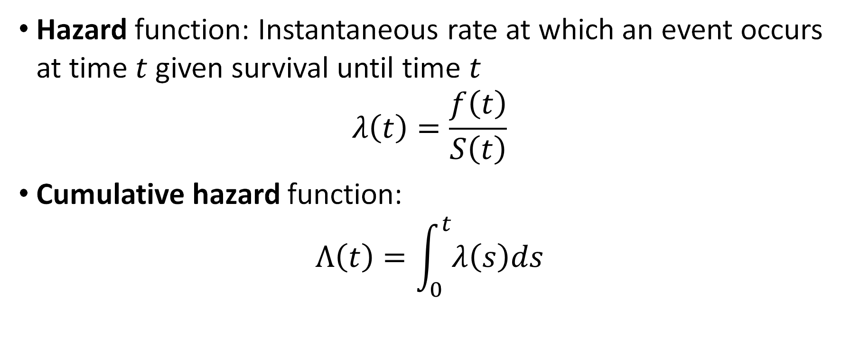
Survival analysis in a nutshell
Hazard function: Instantaneous rate at which an event occurs at time $t$ given survival until time $t$
$$λ\left(t\right)=\frac{f\left(t\right)}{S\left(t\right)}$$
Cumulative hazard function:
$$Λ\left(t\right)=\int_{0}^{t}{λ\left(s\right)ds}$$
Notes:
or even the time when they died

Slide 18
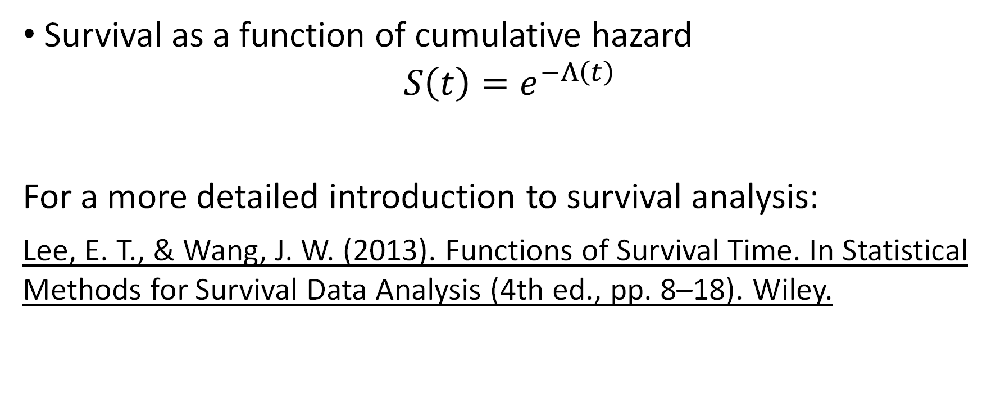
Survival analysis in a nutshell
Survival as a function of cumulative hazard
$$S\left(t\right)=e^{−Λ\left(t\right)}$$
For a more detailed introduction to survival analysis:
﻿Lee, E. T., & Wang, J. W. (2013). Functions of Survival Time. In Statistical Methods for Survival Data Analysis (4th ed., pp. 8–18). Wiley.
Notes:
or even the time when they died

Slide 19
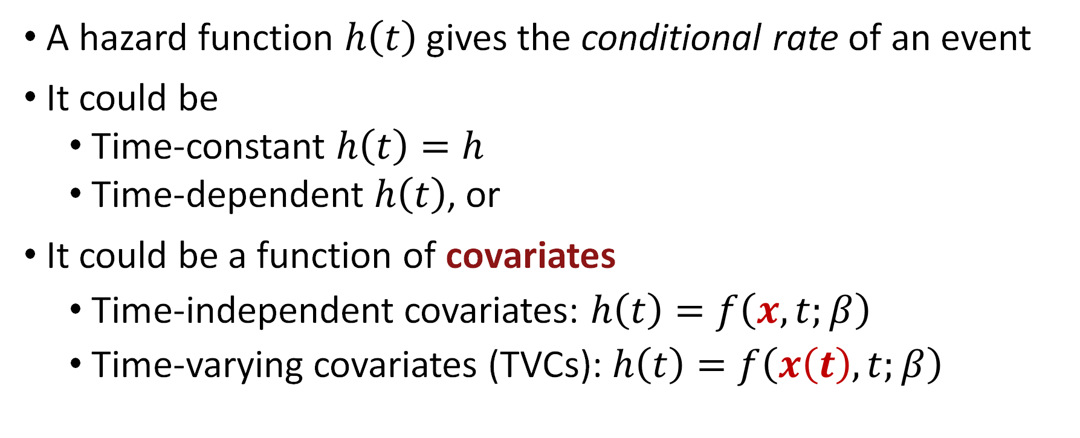
Hazards
A hazard function $h\left(t\right)$gives the conditional rate of an event
It could be
Time-constant $h\left(t\right)=h$
Time-dependent $h\left(t\right)$, or
It could be a function of covariates
Time-independent covariates: $h\left(t\right)=f\left(x,t;β\right)$
Time-varying covariates (TVCs): $h\left(t\right)=f\left(x\left(t\right),t;β\right)$
Notes:
or even the time when they died

Slide 20
Sampling times to event
From parametric distributions
Exponential
Gompertz
Weibull, etc.
From nonparametric distributions
Kaplan-Meier
Nelson-Aalen
Life tables
Notes:
or even the time when they died

Slide 21
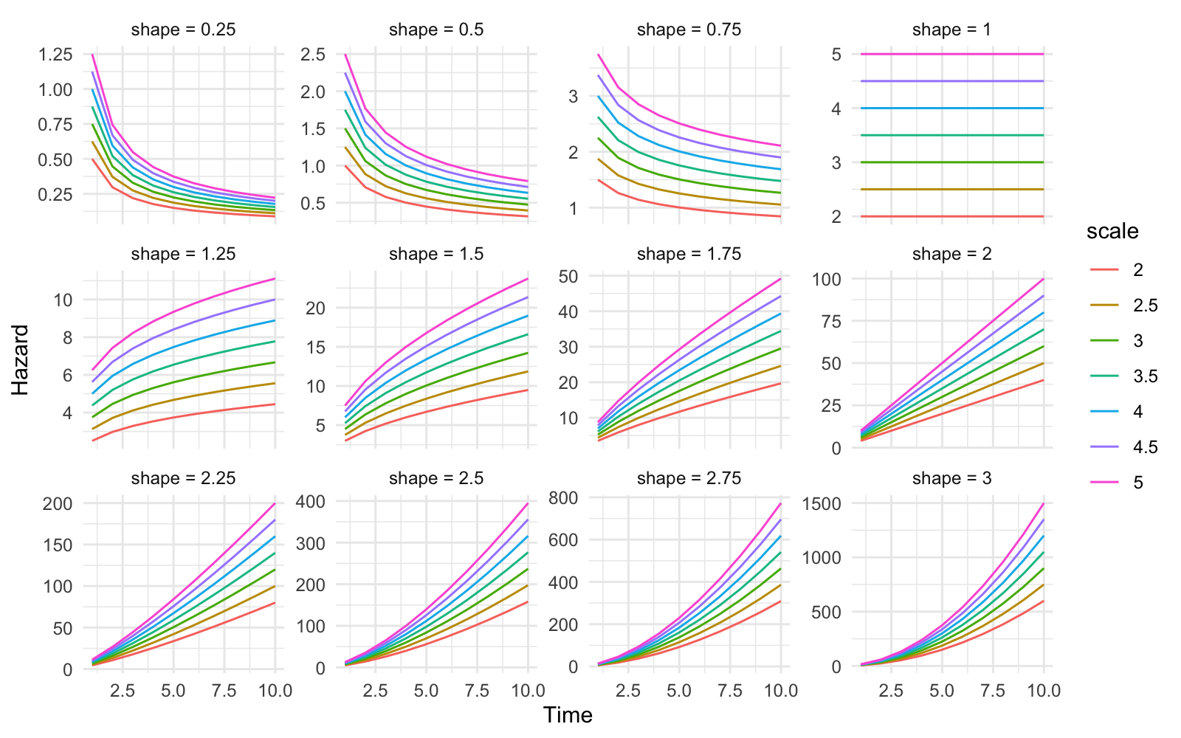
Parametric hazards: Weibull
Source: https://devinincerti.com/2019/06/18/parametric_survival.html
Notes:
or even the time when they died

Slide 22
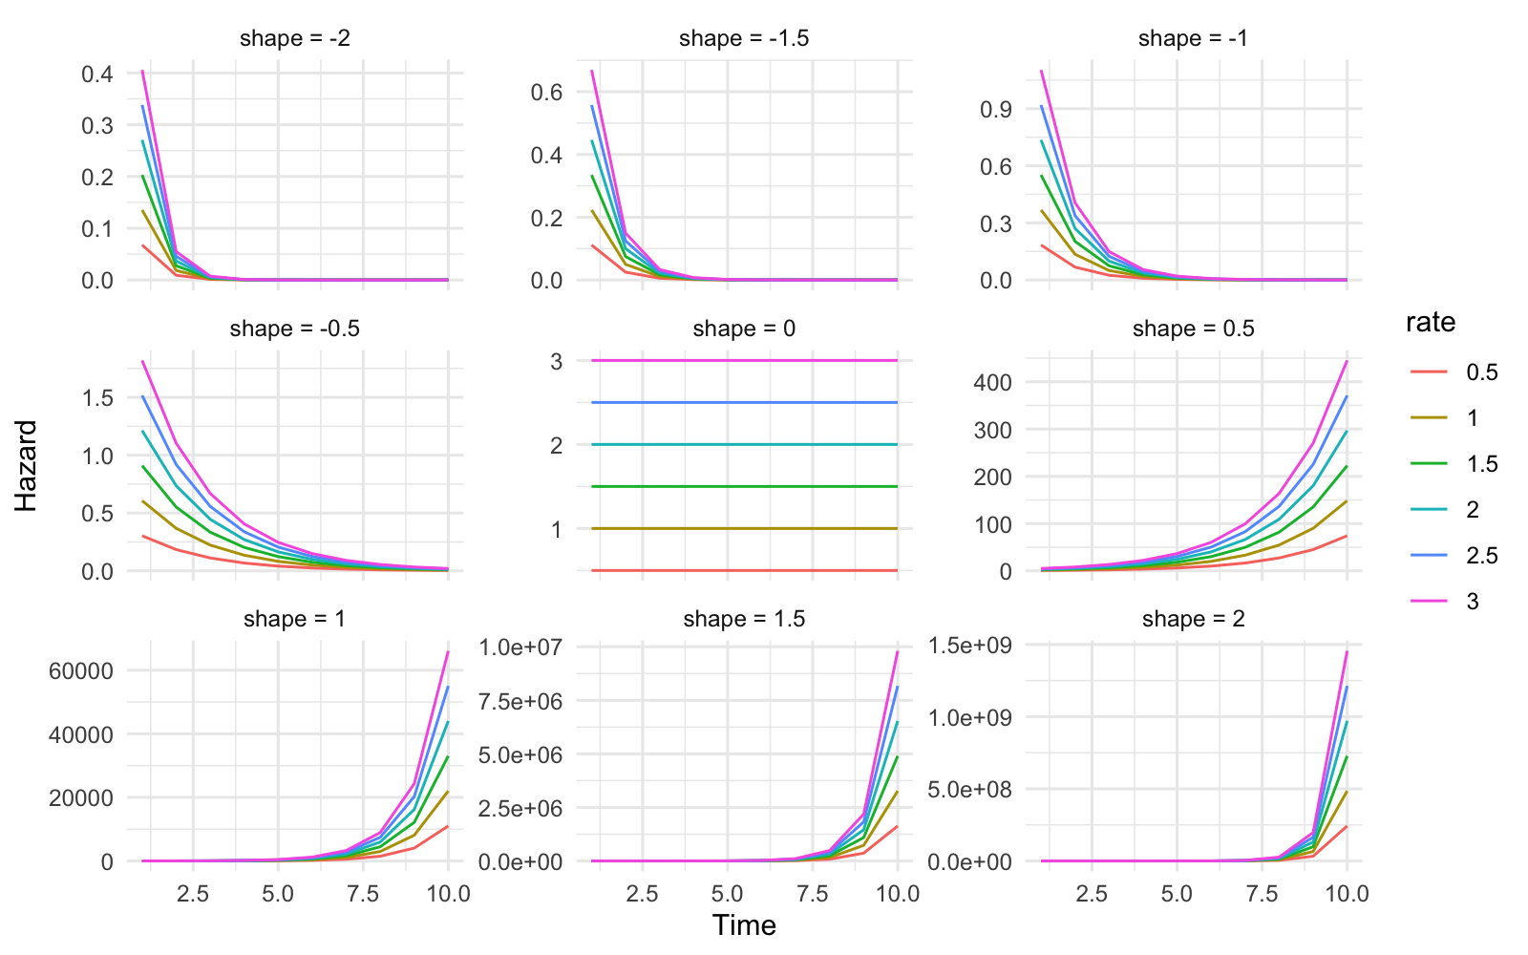
Parametric hazards: Gompertz
Source: https://devinincerti.com/2019/06/18/parametric_survival.html
Notes:
or even the time when they died

Slide 23
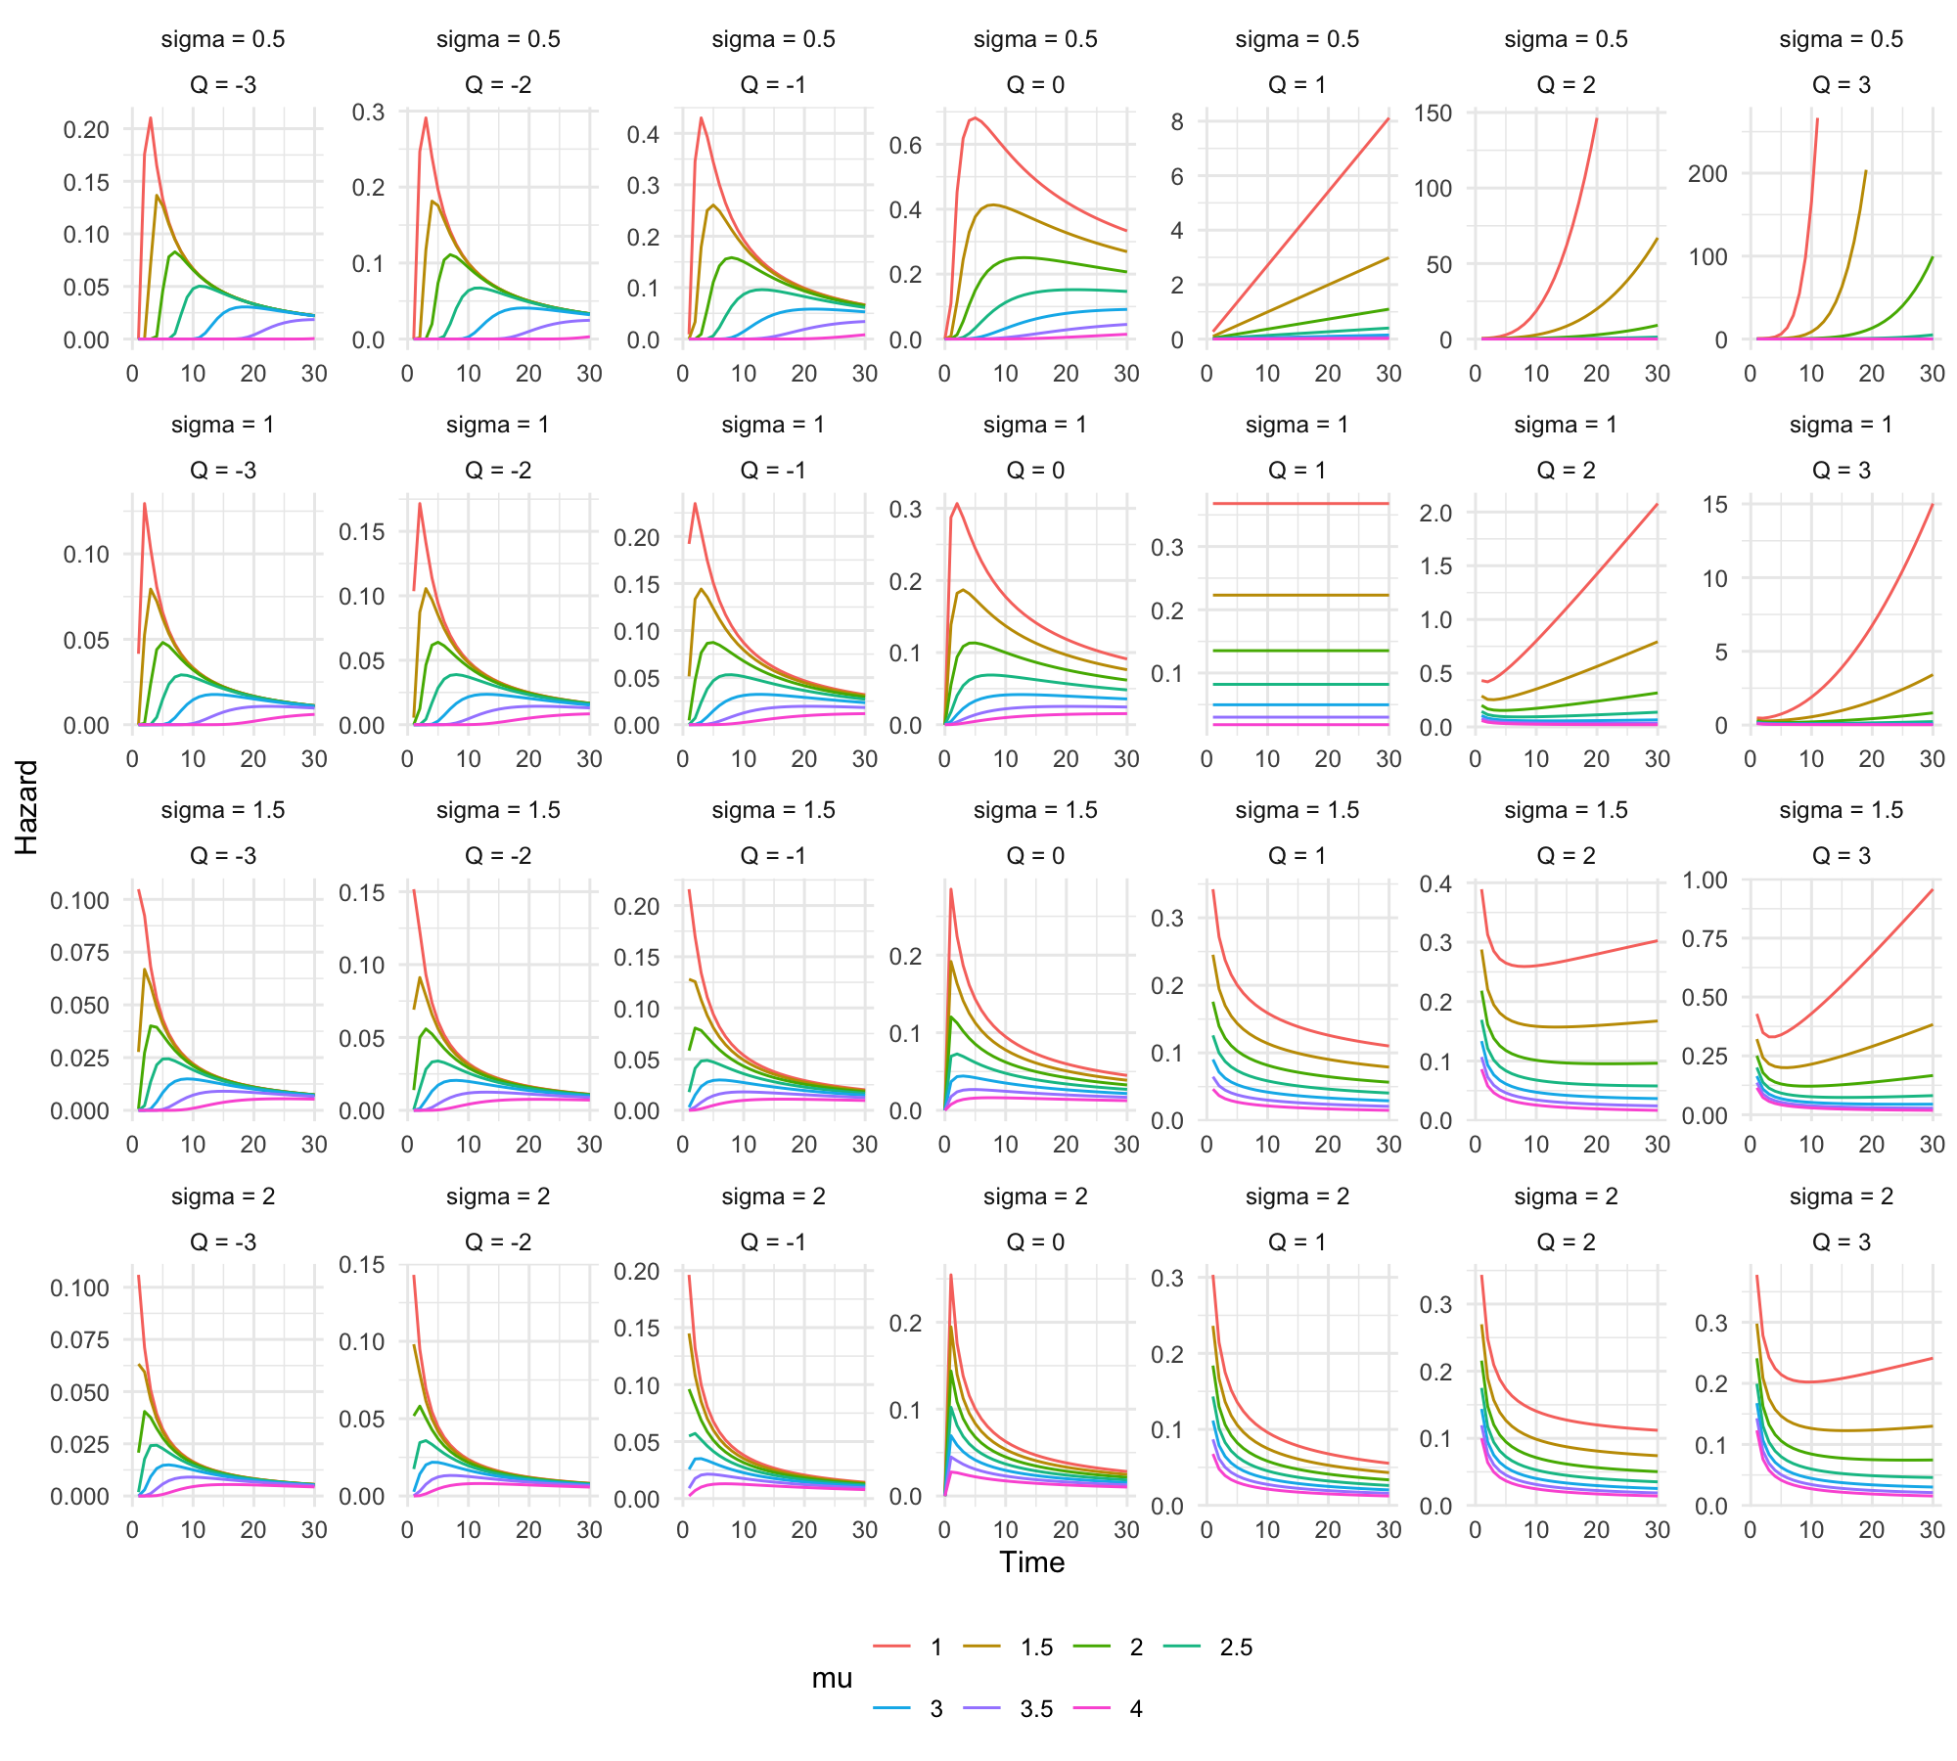
Parametric hazards: Generalized gamma
Source: https://devinincerti.com/2019/06/18/parametric_survival.html
Notes:
or even the time when they died

Slide 24
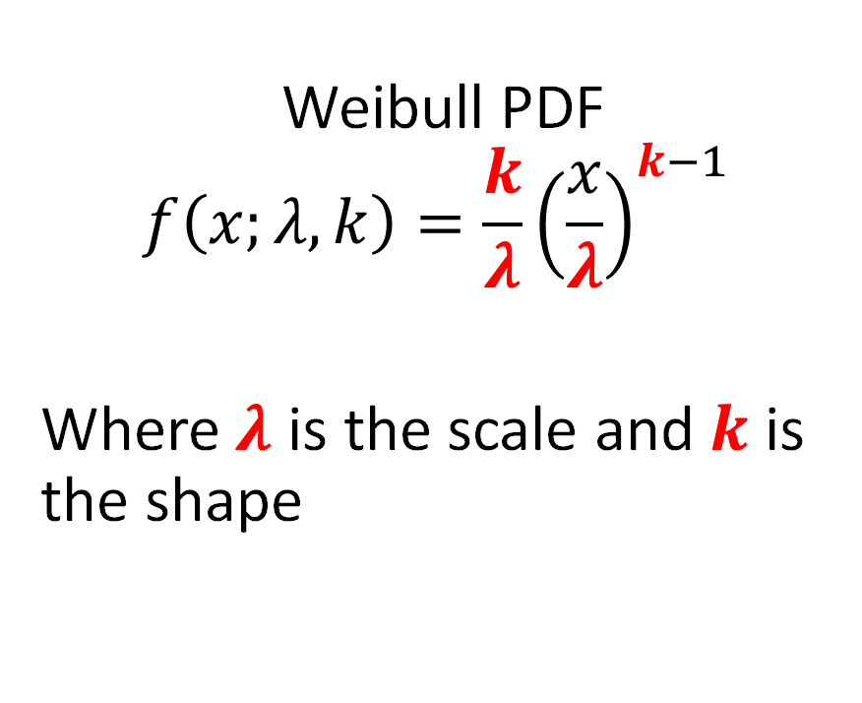
Sampling times to event
Sampling times to event following non-constant hazards is often done by drawing random values from parametric distributions
Weibull PDF
$$f\left(x;λ, k\right)=\frac{k}{λ}{\left(\frac{x}{λ}\right)}^{k−1}$$
Where $λ$ is the scale and $k$ is the shape
Notes:
or even the time when they died

Slide 25
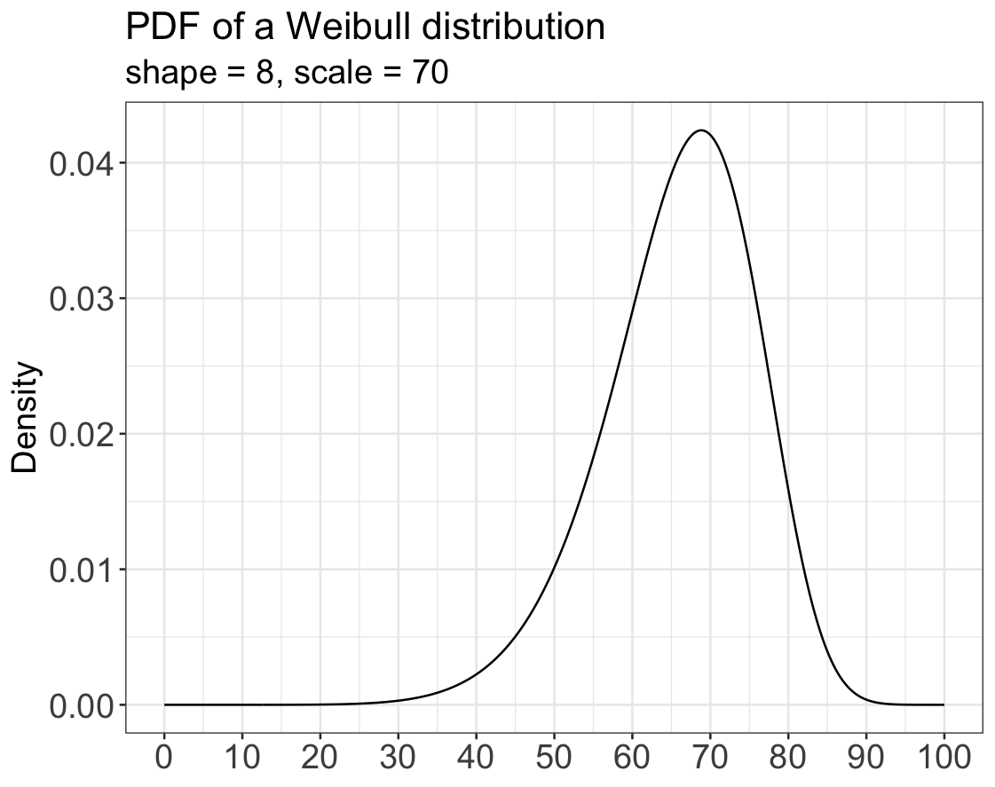
Sampling times to event
Sampling times to event following non-constant hazards is often done by drawing random values from parametric distributions
Notes:
or even the time when they died

Slide 26
Sampling events
One individual at a time
-> inefficient in high-level languages like R or Python
Event 1
Event 2
…
Death
Event 1
Event 2
…
Death
…
…
…
…
…
Event 1
Event 2
…
Death
Notes:
or even the time when they died

Slide 27
Sampling events
One event at a time
-> efficient in high-level languages like R or Python
Event 1
Event 2
…
Death
Event 1
Event 2
…
Death
…
…
…
…
…
Event 1
Event 2
…
Death
Notes:
or even the time when they died

